Slide 1
Leadership Development for Chapter Presidents
Membership
June 2022

Slide 2
Michelle Grandinetti, TSO 2nd Vice President
Phyllis McPherson, TSO Membership Chair
Janet Pipkin, Member Extraordinaire, Gamma Xi

Slide 3
“As the driving force of our legacy, membership involves relationships between a welcoming environment and an engaging organization.”
Denese Wolff-Hillard, Lambda Sigma

Slide 4
Types of Membership
Active
An active member shall be a woman who is or has been employed as a professional educator at the time of her election. An active member shall participate in the activities of the Society.
Reserve
Reserve membership shall be granted only to a member who is unable to participate fully in the activities of the chapter because of physical disability and/or geographic location.
Reserve status shall be granted by a majority vote of the chapter.
b. A reserve member, so requesting, shall be restored to active membership.
Honorary
An honorary member shall be a woman not eligible for active membership who has rendered notable service to education or to women, and is elected to honorary membership in recognition of such service.

Slide 5
Collegiate
Collegiate members shall be undergraduate or graduate students who meet the following criteria:
Undergraduate student collegiate members shall
(1) be enrolled in an institution offering an education degree and have the intent
to continue academically and professionally in the field of education; and
(2) be enrolled within the last two years of their undergraduate education degree.
b. Graduate student collegiate members shall have graduate standing in an institution offering an education degree and have the intent to continue academically and professionally in the field of education.
When a collegiate member starts her career as a paid educator, she will pay active member dues and become an active member. If a collegiate member does not pursue a career as an educator, her membership will expire upon graduation or withdrawal from the education degree program
State Organization Member- Active or Reserve

Slide 6
Active Members – may participate in all the duties of the Society.
Honorary, Reserve, Collegiate members - may participate in all the duties of the Society except hold office.
Any individual can be the Parliamentarian as that position is not an office.
An individual becomes a member at the time dues are paid.
A vote is needed for a member to become Reserve. A Reserve member can return to Active membership. No vote is needed.
A member can resign without the vote of the chapter. A member who has left DKG can be reinstated. No vote is needed.

Slide 7
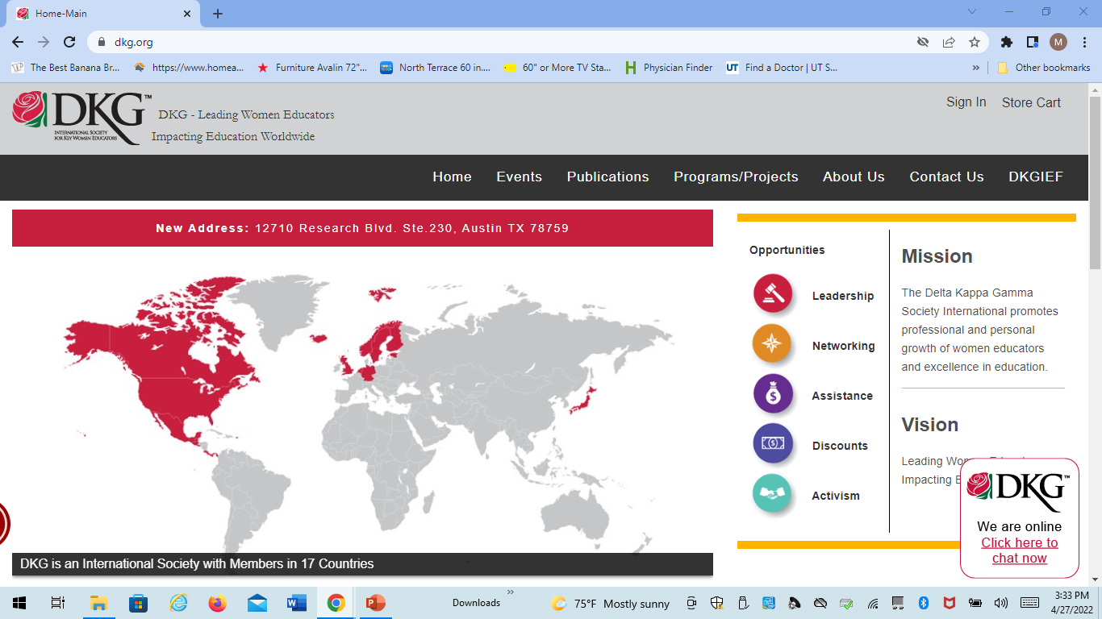
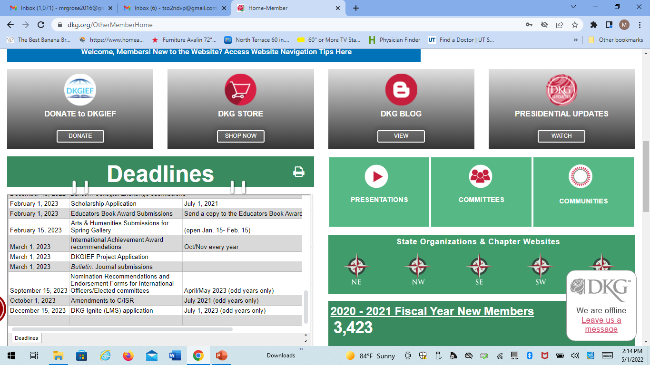
Descriptions of each type of membership can be found on the international website. Go to dkg.org.

Slide 8
The Membership Plan
(The Recruitment Plan)
Can be found at
dkgtexas.org/Committees/Membership

Slide 9
The Prospect Card
Name:
Address:
Phone:
Email:
Employer:
Position:

Slide 10
The (Name) State Organization, (Name) Chapter
Date of Prospect Letter
Name of Prospect
Mailing Address
City, State, Zip
Dear First Name:
A member of (Name) Chapter of The Delta Kappa Gamma Society International, (sponsor’s name), has enthusiastically recommended you for membership in (Name) Chapter of The Delta Kappa Gamma Society International. All of us would personally like to see you become a member of our Chapter.
The Delta Kappa Gamma Society International is a professional honorary Society of women educators. The Society promotes professional and personal growth of its members and excellence in education. Some of the benefits of membership include scholarships, grants, a professional journal, and state and international conferences where networking and relationships flourish.
Established in 1929, Delta Kappa Gamma has attained major objectives in improving opportunities for qualified women employed at every level of education, as well as in advancing the status of women educators.
Our current local project is the support of (Name of Project) in (Location of Project). We also join globally with our 17 member countries in the International Project, Schools for Africa, a joint campaign founded by UNICEF, the Nelson Mandela Foundation and the Hamburg Society to promote education for children in Africa. The campaign will increase access to quality basic education for children with a special focus on girls, orphans and vulnerable children.
We meet (number) times during the year for a business meeting, a meal, and a very informative program. Our meetings are held in one of the private dining rooms of (Location), (City), (State/Province/Country).
We want you to give favorable consideration to becoming a member, joining us in the projects and committees that interest you, and participating in our activities. You are invited to be our guest at an upcoming orientation meeting on (Day, Date, Location, and Time of Prospect Meeting). You will meet (Name) Chapter members and learn more about membership in Delta Kappa Gamma. To RSVP, please contact me at (YourEmail), or (Your phone number) by (Date).
Sincerely,

Slide 11
Pride in the Big Picture
…an orientation for potential members
_______ Chapter
________ (geographical) State Organization
________________________ (location)
Notes:
The invitation to membership should invite the prospective member to an orientation about the organization, also giving the date of the initiation. The letter should state that she will be asked to make a membership decision at the end of the orientation. For sample letters, visit “Recruitment Plan” under the Resources tab on the DKG Website.
The purpose of this PowerPoint is to provide a common outline for orienting prospective new members to the Society. It should be used in a session (preferably with most chapter members attending) weeks/days prior to the scheduled initiation so that the candidate has time to gracefully withdraw if the invitation is not appropriate for her at this time. This presentation should lead to thoughtful reflection on the part of the invitee. Acceptance then means an informed commitment to the organization. Orientation on the day of initiation (or immediately preceding initiation) means the invitee is “trapped.”
Establish a welcoming, comfortable environment for the presentation. Provide name tags for prospects and presenters. Arrange the room to prevent issues with visibility and sound. If necessary provide signs at the entrance of the building to assist guests with finding the appropriate room. Assign a chapter member to be a “mentor” to each prospective (or to two) member(s) to guide them through the orientation and the first year of membership.
Chapter name can be described in the introduction and the fact that this is an orientation for active membership.

Slide 12
The Name State Organization, Name Chapter
Date of Induction Letter
Name of Prospect
Mailing Address
City, State, Zip
Dear First Name (+:)
Congratulations on being elected to membership in (Name) Chapter of The Delta Kappa Gamma Society International. Membership is by invitation only and considered a prestigious honor. Members are empowered with new knowledge and professional development targeted towards reaching their full potential.
Upon induction, you will become part of more than 75,000 DKG members impacting education worldwide. We have planned the induction ceremony rehearsal for you to be held on _________ at __________________________.
Your induction will be held as part of our (Month/Date) meeting in (Location), (City, State/Province/Country) on (Day), (Date), (Time). We look forward to your participation in our chapter activities, projects, and fellowship.
Please contact me regarding your attendance at both the rehearsal and the induction ceremony as soon as possible, but no later than (Date) at (your email address) or (phone number).
Welcome to (Name) Chapter!
Sincerely,
(Chair Name), Membership Chairman
Chapter Name, State Organization

Slide 13
Who to invite to membership?
This Photo by Unknown Author is licensed under CC BY-NC

Slide 14
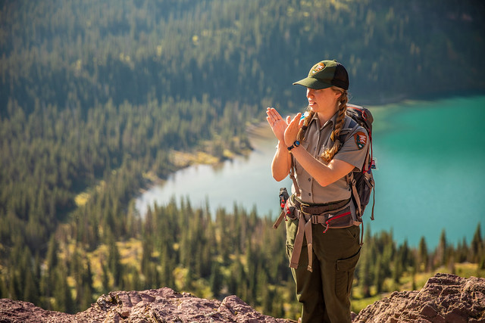
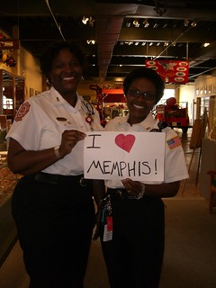
Educators completing their certifications. Consult a local campus
Educators who have received Grants-in-Aid.
Educators who have been selected Teacher of the Year
Educators in non-traditional fields such as……
non-profit organization education directors
park rangers
museum education staff
religious education directors
school nurses
city department trainers
day care directors/providers
Educators in other groups such as…
the garden club
church
TRTA
book clubs
choirs……
Explore all opportunities
This Photo by Unknown Author is licensed under CC BY-NC-ND
This Photo by Unknown Author is licensed under CC BY-NC
This Photo by Unknown Author is licensed under CC BY-NC-ND

Slide 15
And once they are members………

Slide 16
Mentor
Supervise
Encourage
Aide
Coach
Help
Consult
Advise
Guide
Instruct
Teach
Tutor
Council
Direct
Partner
listen
This Photo by Unknown Author is licensed under CC BY-SA

Slide 17
Why Mentor?
Some people are shy
Or reserved
Or introverted
Or confused by DKG
Or overwhelmed by the experts

Slide 18
M- Messenger
E - Encourage and Explore
N – Nuture
T - Teach/ Tutor/ Trust
O - Open your ears and your mind
R - Reflect and Resource

Slide 19
What does mentoring look like?
At the personal level
Explain DKG (What’s ASTEF?)
Call
Bring to meeting
Encourage involvement
Partner with them on an activity
Remind them about meetings, etc.
Suggest your mentee share a skill/talent/expertise
Recommend a committee
At the chapter level
Encourage interactive activities for the chapter
Tap into your membership for programs/projects/chapter activities
Be open to new ideas new members bring!
Maybe have a chapter discussion and choose specific ways your members will mentor.
Be consistent. Be mentored!

Slide 20
Nurture: Develop relationships with current and new members
Serve: Choose a time to give to others.
Educate: Promote the purposes and mission of DKG to others
Wonder: Dream, Ask, Reflect

