Slide 1




LDCP Session 4
Programs, Projects, ASTEF and Resources
Everything you ever wanted to know in 45 minutes!

Slide 2


Why Focus on Programs?
Programs draw members to your meetings
Programs provide information, knowledge, and skills
Programs provide value and relevance both professionally and personally
Programs provide leadership learning
Programs provide leadership opportunities
Programs provide networking and connections
Programs retain and sustain members

Slide 3

Program Ideas
Educational Focus – why we exist
Personal and/or Professional Development
Connections and Relationships
Leadership
Communication and Publications
Legislative and Advocacy
Global Awareness
Research and Archives
Scholarships and Awards
Technology and Social Media
Membership and Necrology
Women in the Arts
Hobbies, Interests, Outside the Box FUN
Whatever you can Imagine is a program!
Be Creative

Slide 4
Where do Projects fit in the Journey?
NURTURE –
  Provide a common goal to aid in developing relationships with chapter members.
SERVE –
  Provide an opportunity to give to others in the chapter, schools, community and worldwide
EDUCATE –
  Promote the purposes and mission of DKG to others.
WONDER –
  Dream about the possibilities, Ask what more your chapter can do, Reflect on the impact

Slide 5

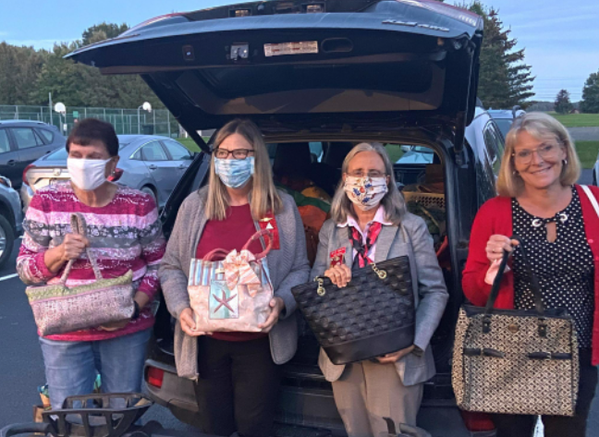
International Projects
Schools for Africa
Supporting Early-career Educators (SEE)
TSO Projects
Convention Unifying Project
School/Community Projects
Convention Program (Chapter Spotlight Projects)
ASTEF Project Stipends
Project Spotlight – International Website

Slide 6




In 2021, ASTEF awarded $10,500 in project stipends for 14 individual and chapter projects such as Family Summer Reading, supporting Early Career Educators, anti-bullying campaigns, providing classroom supplies, feeding kids through Bill’s backpacks, and much more.

Slide 7

The ASTEF website is the place to go for more information about ASTEF.
The HOME PAGE will provide you with the most up-to-date, current ASTEF information.
Click on HOME tab and Board of Directors to see a list of current board members. Invite a board member to one of your meetings.
Website: www.astef.org

Slide 8
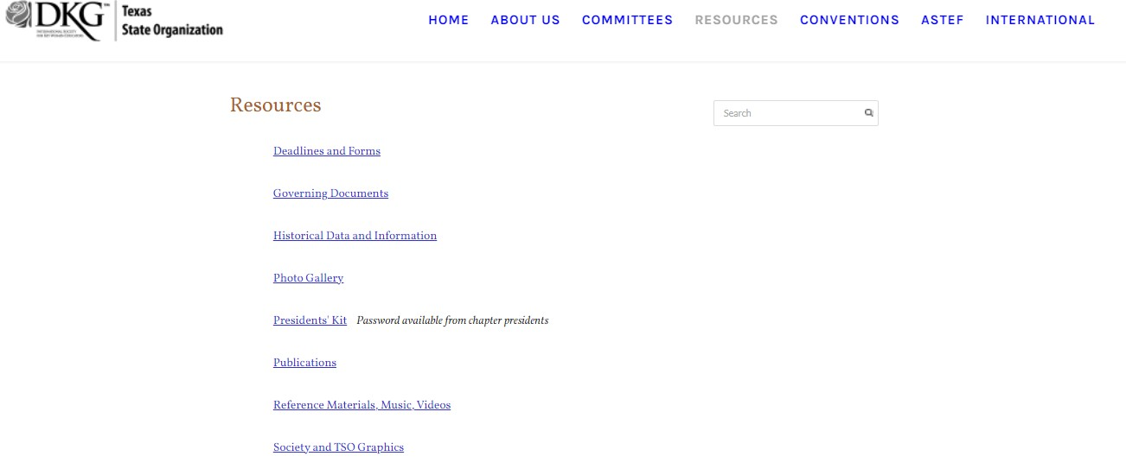
Resources
President’s Kit – one-stop source for valuable information
Password: Journey21&23
-calendar
-important contact information
-list of chapters and presidents
-list of state and TSO personnel
-letters to chapter officers from their TSO counterparts

Slide 9
Additional Resources
Bylaws and rules- can be found on the Resources page OR on the Bylaws and Rules Committee page
State Rules and Bylaws
International Constitution and Standing Rules
Model chapter rules (committee page)
Guidelines for Chapter Presidents
Available on the DKG International website (www.dkg.org)
Must have an account (username: Member #; password: dkg2014society IF you have never logged in before)

Slide 10



Webpages/Social Media resources
DKG website www.dkg.org
TSO website www.dkgtexas.org
State and chapter websites- accessed in the “About Us” section of the International website
Social media Facebook: DKG-Texas State Organization
Instagram: @dkgsi
Twitter @DKG_SI

Slide 11

Phone a Friend
Area Coordinator
TSO Area Mentor
TSO Committee members
TSO Headquarters
DKG Headquarters
All contact information is listed in the President’s Kit

