Slide 1
$mall Projects of the Heart
WELCOME
PLEASE SIT IN GROUPS BY AREA
Which roses are best friends in a garden?
Miriam Melian Crellin
Nu Epsilon
miriamthirtyone@gmail.com

Slide 2
About Us
Your Turn
Chapter Area
Joined or Chartered
Members (Retired?)
Attendance
School District
Fundraiser ?
Nu Epsilon Area 7
Chartered 2019
25 Members (6 Retired)
10-15 In person meeting attendance
Pflugerville Independent School District
No Fundraiser at that time
Chapter Projects less than $200

Slide 3
IN THIS SESSION
Change tables, share ideas, take a photo. World cafe
Communicate 3 kinds of projects
Collaborate with table group to create a chart of chapter projects under$200

Slide 4
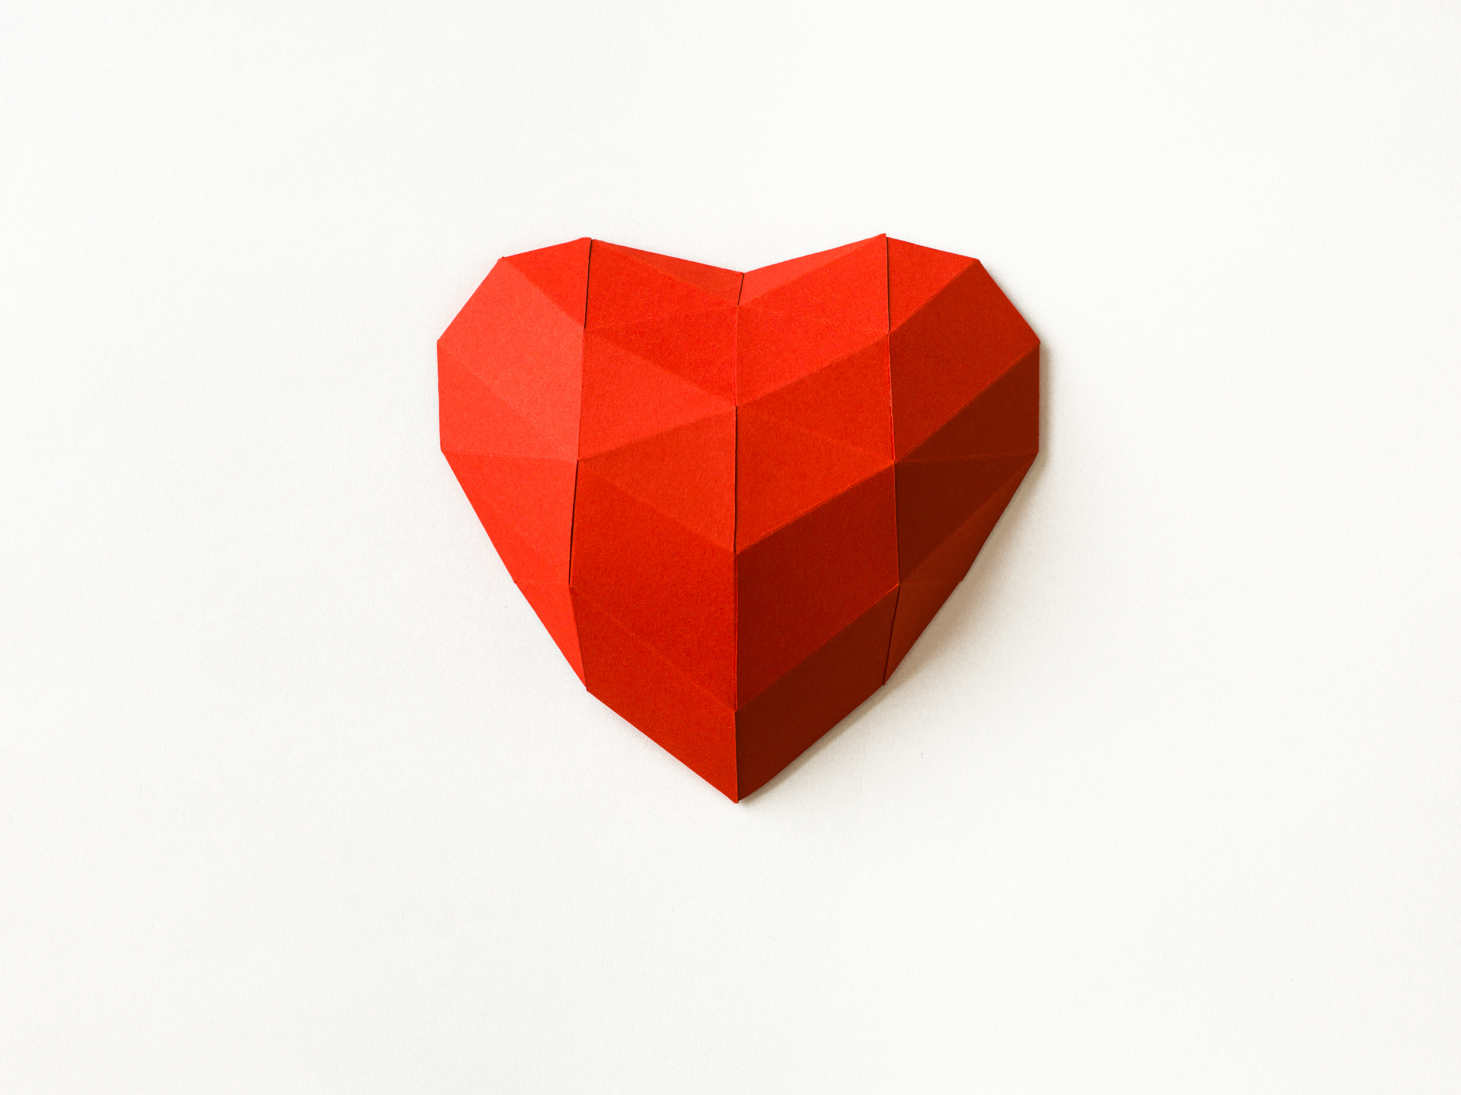
https://christicenter.org

Slide 5
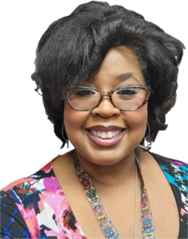
SISTER IN NEED
Act of Service
3 hours of time
Retired Members

Slide 6
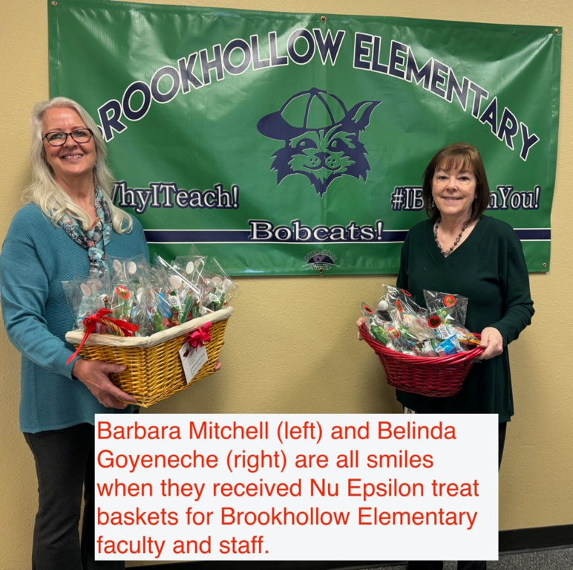
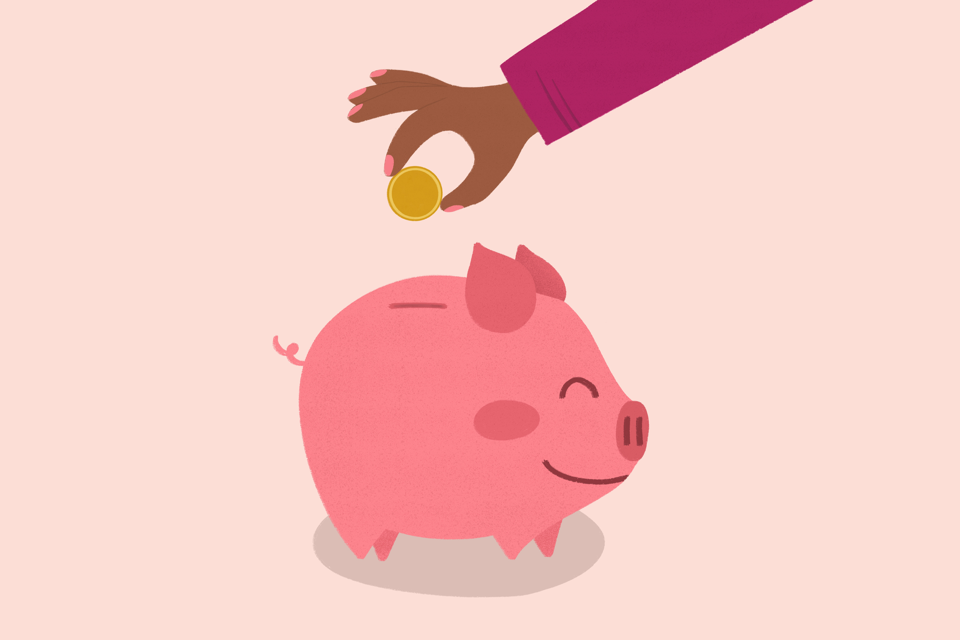
Members & Guests Participation
About $400 for 590 Faculty and Staff from 6 schools. About $67 per school.

Slide 7
$mall PROJECTS of the
Project Recipient | What | Project Description | Materials & Resources | Time | Cost | Notes
Community | Student Loss | Plant & Card | Plant, card, grief brochure | < 1 hour | $40 | Executive Team: Request from PfISD Administration-
Sisterhood | Act of Service | Organize library | Lunch | >3 Hours | Time/ Lunch | Membership Committee & Retired Members
Area School | Appreciation | treat baskest for Entire staff and faculty. 2 Elementary Schools or 1 Middle or High School | self seal bags 6X9, chocolate, fruit, healthy salty, Labels, encouragement cards Costco | 1 or < | $67 per school | All members Pre-meeting gathering, Baskets were donated, Assembly line production, Guests and Members

Slide 8
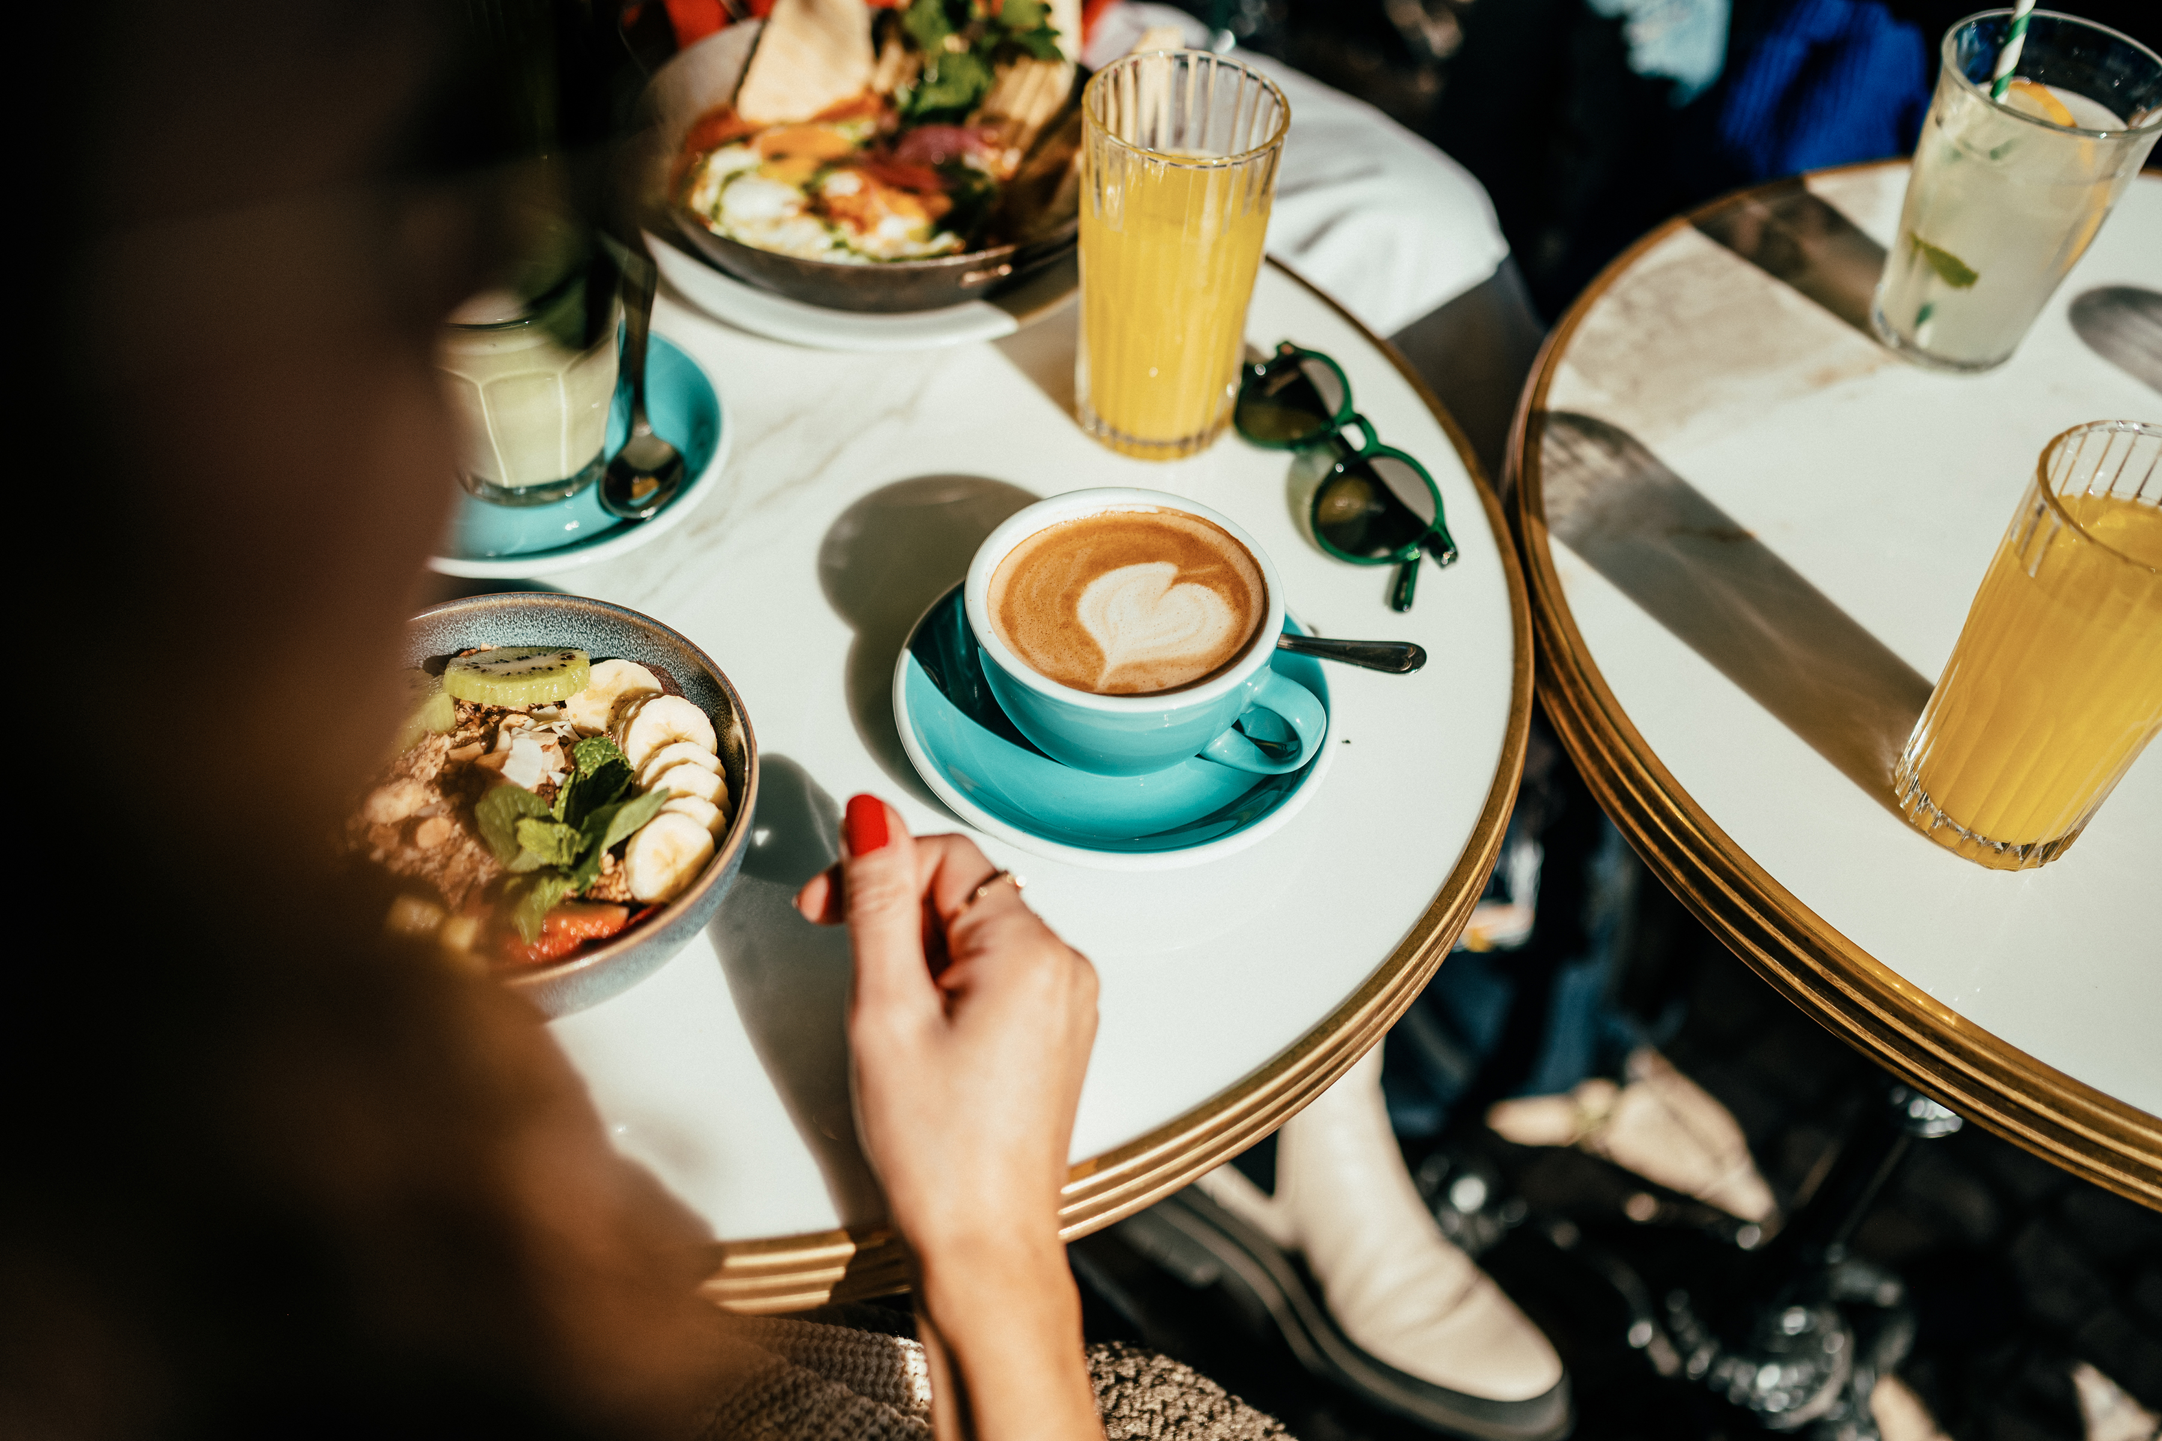
WORLD
CAFE
Each table group has a unique color.
Each group member becomes a representative using the group’s color.
One group member will remain at the group’s home base table.
The other members seek different tables to be the only representative from their color group.
In this way, new table groups are formed with member representation from each color group.
Bell rings and the home base member shares the project and answers questions. Each person takes a photo of the project.
The group signals a completed discussion to the room facilitator or completes their discussion 1 minute after the facilitator’s signal.
At the facilitator’s signal the newly formed groups will rotate around the room clockwise and visit another table. At each table there will be a representative from the table’s color to share with the group.

