Slide 1
Your Chapter’s Financial Journey: Dues, Paperwork & Portal
Presented by: TSO State Treasurer – Deborah Thomas
TSO Executive Secretary – Leesa Cole
TSO Finance Committee
Graphics are from TSO website

Slide 2
First stop on our Journey through the dues process.
Texas State Organization website – www.dkgtexas.org
What can you find on this stop?
Home page, then locate resources, then scroll down to the Treasurer’s section
TSO Fee Form – print several of these because you need one for every order you send to TSO
List of items to send with each order
Checklist to make sure you completed everything
Also, many other great help sheets to use for completing Form 15, 990N and dues process

Slide 3
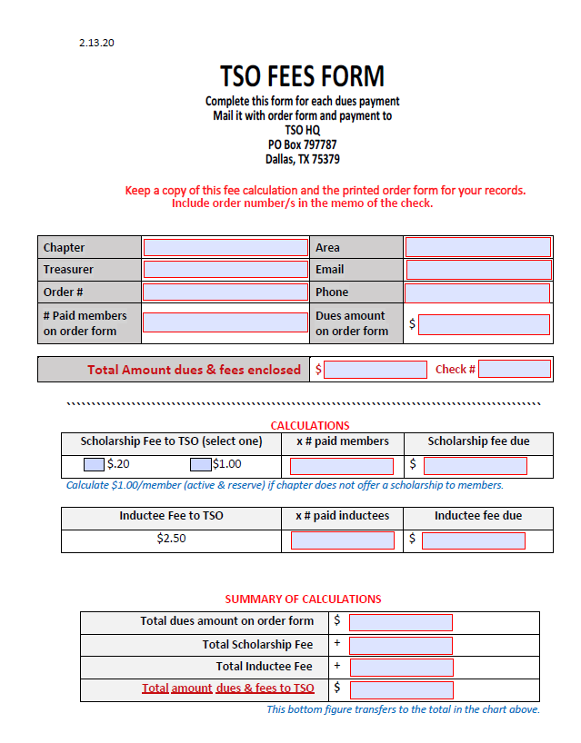

Slide 4
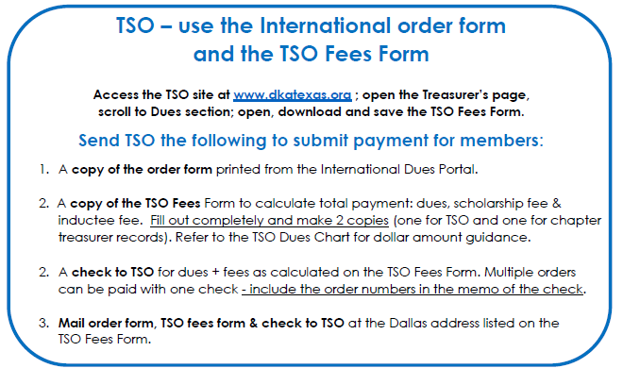

Slide 6
Second Stop on our journey through the dues process
Delta Kappa Gamma International www.dkg.org
Before entering the portal make sure your information is correct on the “my account” page.
If anything needs correcting, please update.
Next click on chapter connect and download your chapter roster. Get the membership chair or someone to help you make sure every members information is up to date. Please encourage members to not use school emails they often bounce back.
Next scroll down the page and you will find additional resources and forms to use from International.

Slide 7
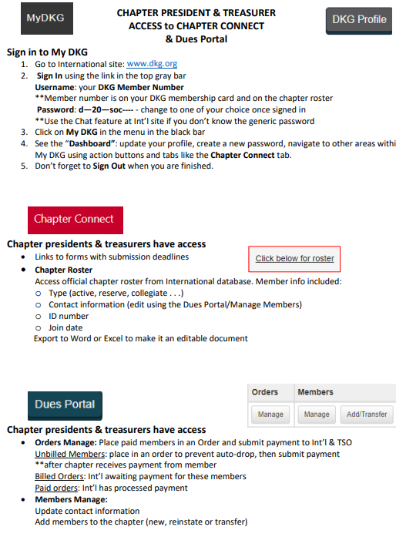
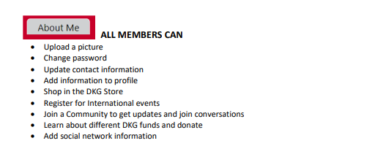

Slide 8
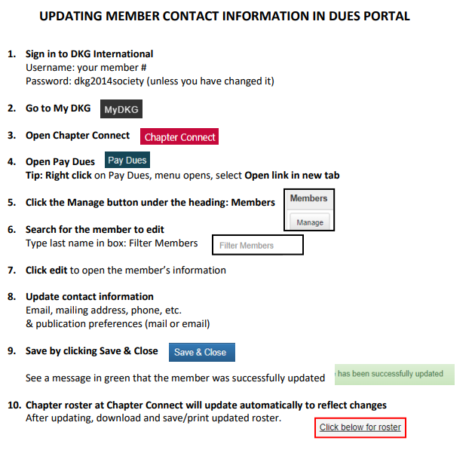

Slide 9
Welcome to the Dues Portal
Now you are ready to click on the dues portal button.
To mark a member as paid use the Orders – Manage button
To add new members use the Add/Transfer button and the Members Manage button.
Remember before you add a new member you need to have their dues and membership form complete with birthday.
Once they are entered you can go to Order Manage and enter them as paid.

Slide 10
Ready to send in an order
Print 3 copies of the order form
Get out a copy of the TSO Fee Form
Get out the checklist of what to send where
Complete the Fee Form and checklist
Mail one copy of the order form and fee form along with a check to TSO. Address is at the top of the fee form
Mail one copy of the order form and a check to International. The address is on the order form. Remember they have a new address.
The last copy is yours to keep with the checklist and add the receipt once received.

Slide 11
Questions you might wonder about!
Can I send in more than one order at a time? Yes, you can send as many as you want just remember to complete the fee form.
Do I collect all my chapter dues before I put the members in an order form? Please enter your members in an order form as soon as they pay. You do not want members that have paid getting emails that they haven’t paid when they have.
The goal is to have all your chapter dues collected by the end of June.
Send your order forms, fee form and checks to TSO and International
by the end of July or sooner.

Slide 12
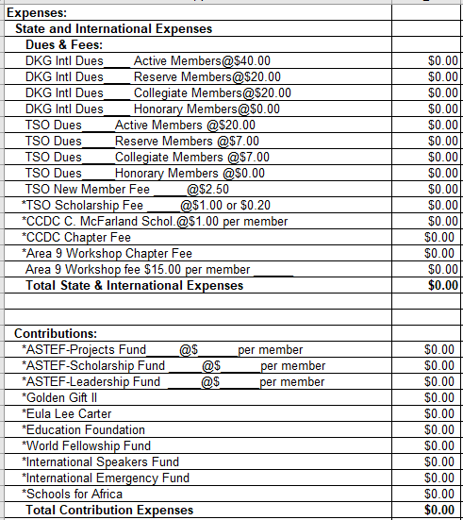

Slide 13
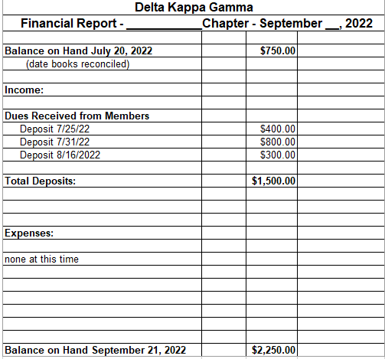

Slide 14
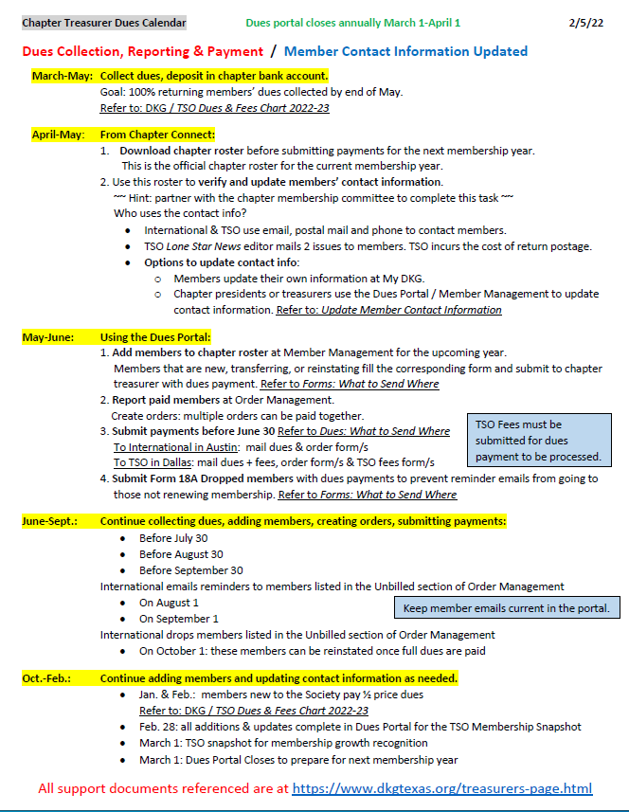

Slide 15
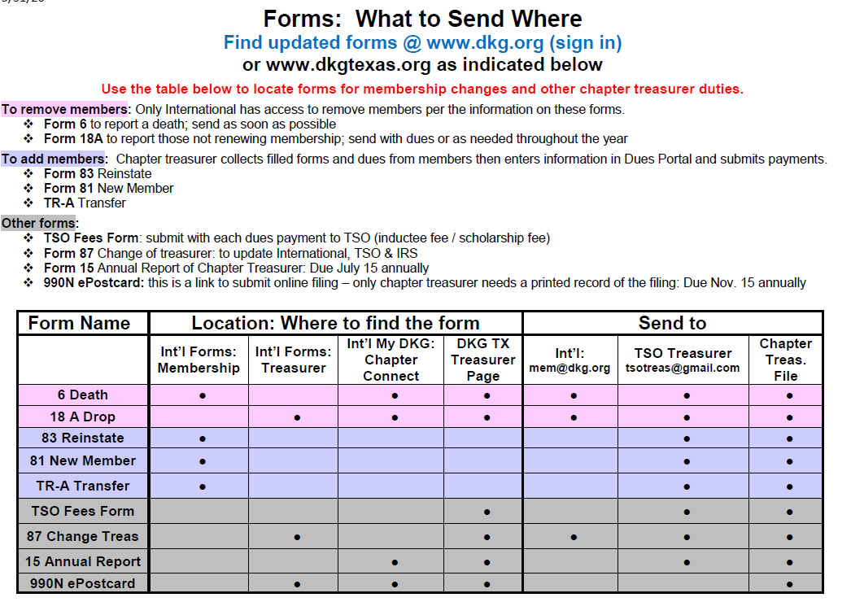

Slide 16
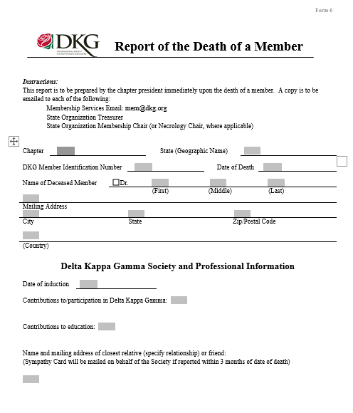
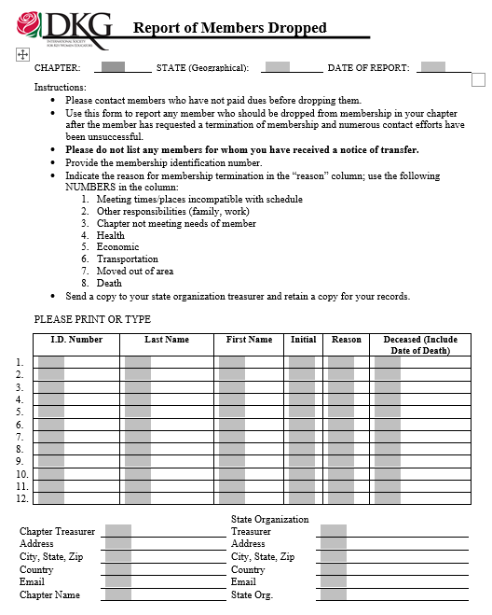

Slide 17
Other Resources to use;
Chapter Treasurers from a nearby chapter or friend
Finance Committee rep assigned to your area
Area Coordinator
Chapter President
TSO State Treasurer
Handout and resources on TSO and International sites
International - Chapter Treasurer’s Community

Slide 18
Thanks so much for coming to our
Treasurer Training
TSO State Treasurer – Deborah Thomas
Email – tsotreas@gmail.com
Headquarters phone number – 972- 930-9945
TSO Executive Secretary – Leesa Cole
Email – tsosecretary29@gmail.com
Headquarters phone number – 972-930-9945
And the wonderful TSO Finance Committee

Slide 19
Information For You!
TSO HQ – TSO Headquarters
TSO Treasurer – tsotreas@gmail.com
TSO Secretary – tsosecretary29@gmail.com
TSO Web Site: www.dkgtexas.org
Mailing Address: P.O. Box 797787
Dallas, Texas 75379
Phone: 972-930-9945
International Headquarters
International Web Site: www.dkg.org
Mailing Address: 12710 Research Blvd.
STE.230
Austin, Texas 78759
Phone: 512-478-5748
2021-2023 Finance Committee Reps
Ella Gauthier (Chair): Areas 1, 2, 3
Sallie Frederick: Areas 4, 5, 6
Susan Harmon: Areas 13, 14, 15
Ellen Laughlin: Areas 7, 8, 18
Sharon McDougle: Areas 11, 12, 16
Pam Phillips: Areas 9, 10, 17

